Slide 1
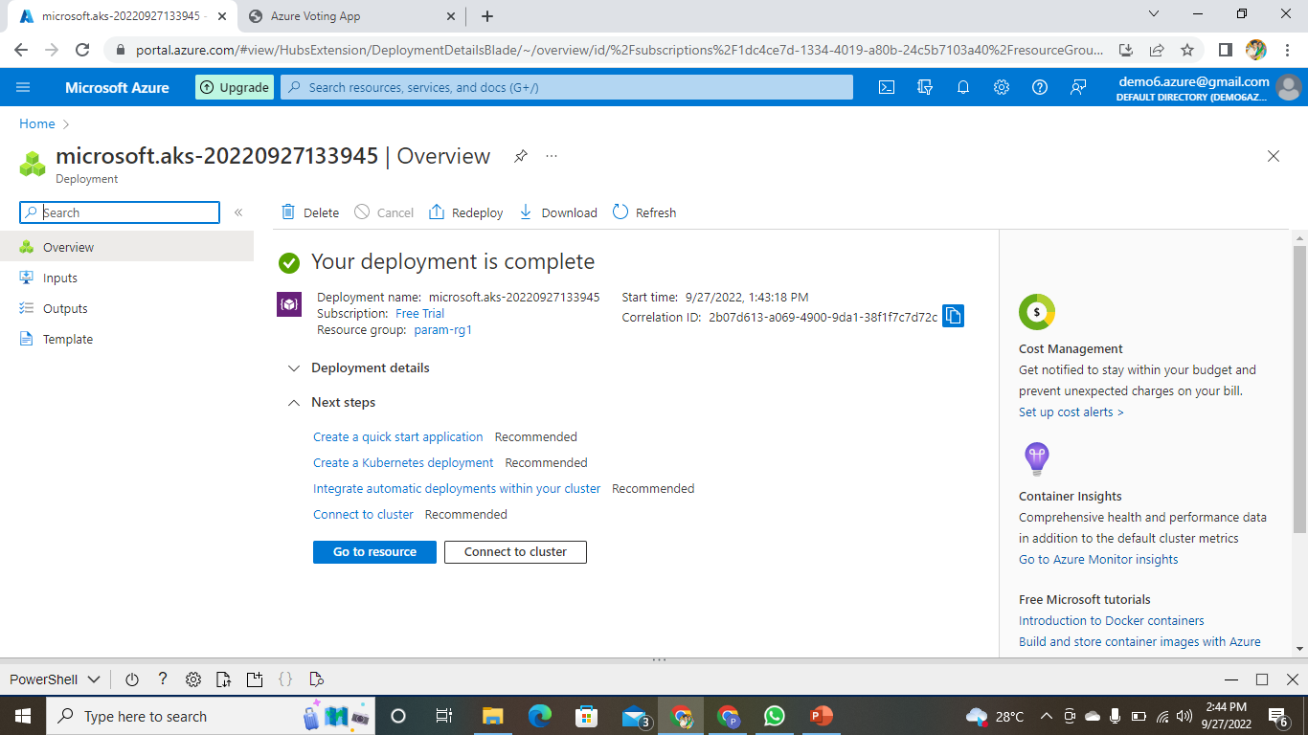
AKS CREATION
CREATING AKS CLUSTER:-

Slide 2
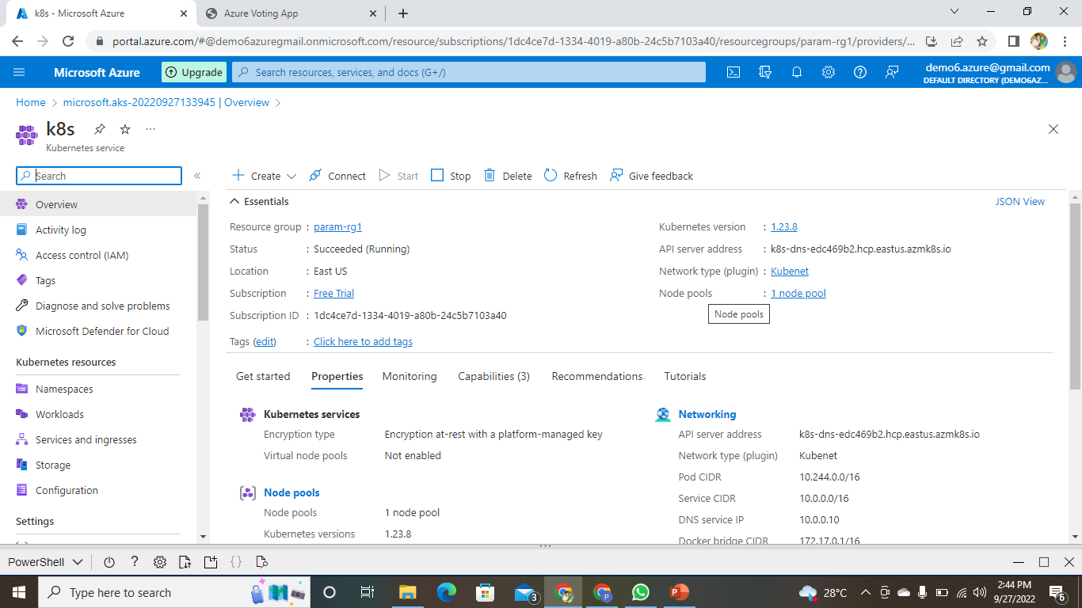
AKS CLUSTER CREATED

Slide 3
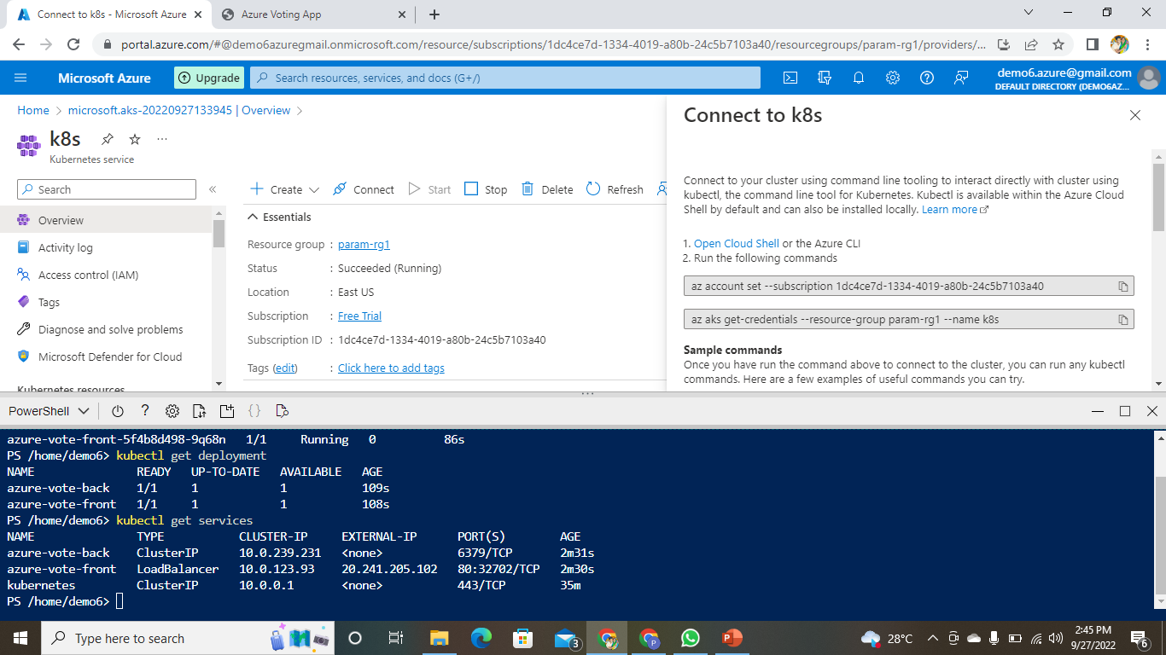
CONNECTING AKS CLUSTER TO P.T

Slide 4
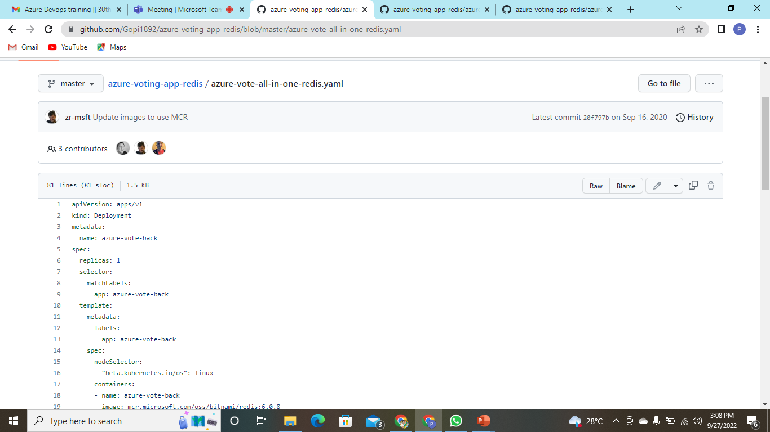
COPY THE YAML FILE

Slide 5
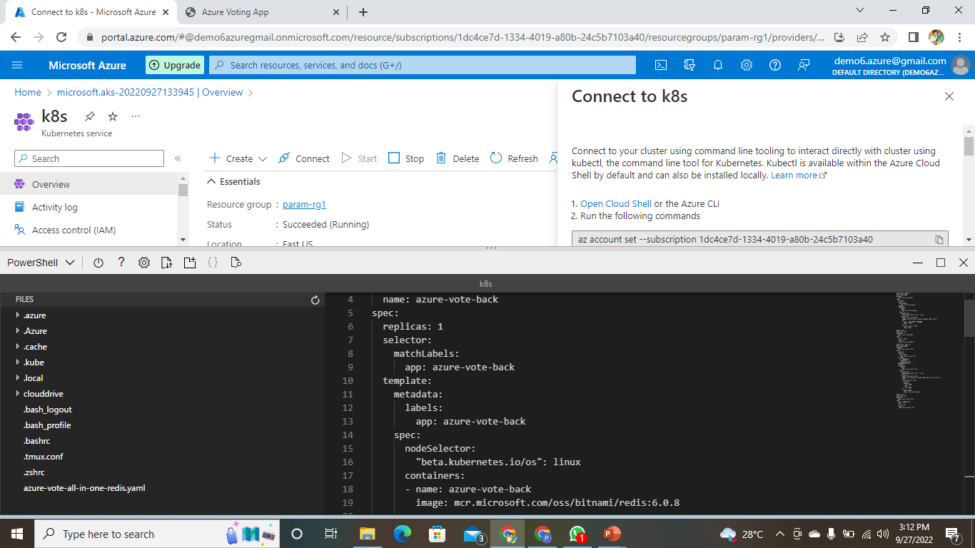
PASTE THE FILE IN THE EDITOR AND SAVE IT

Slide 6
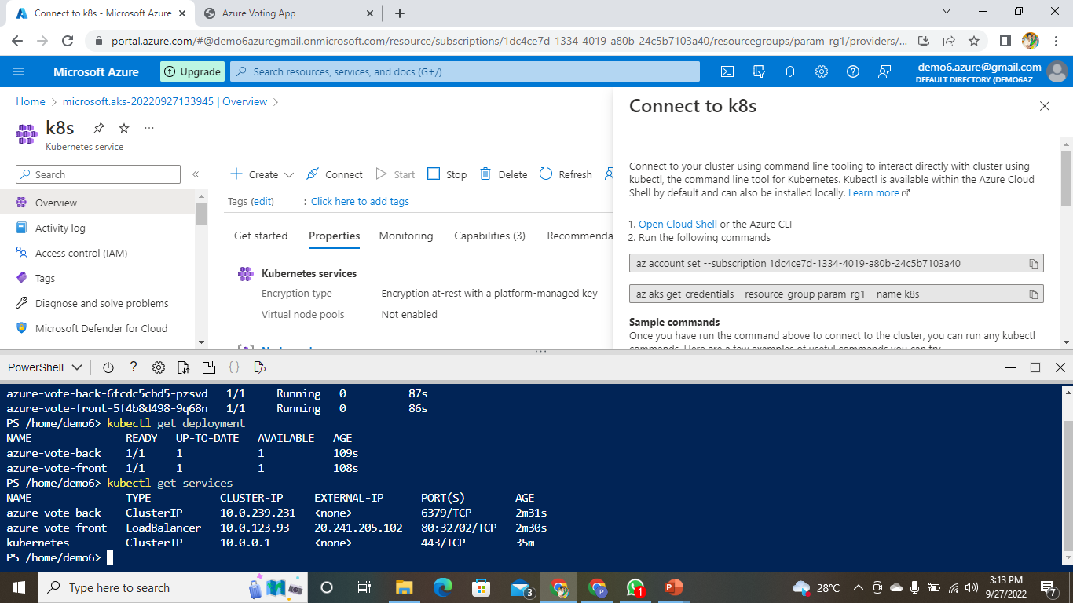
RUN THE COMMAND TO RUN THE YAML FILE

Slide 7
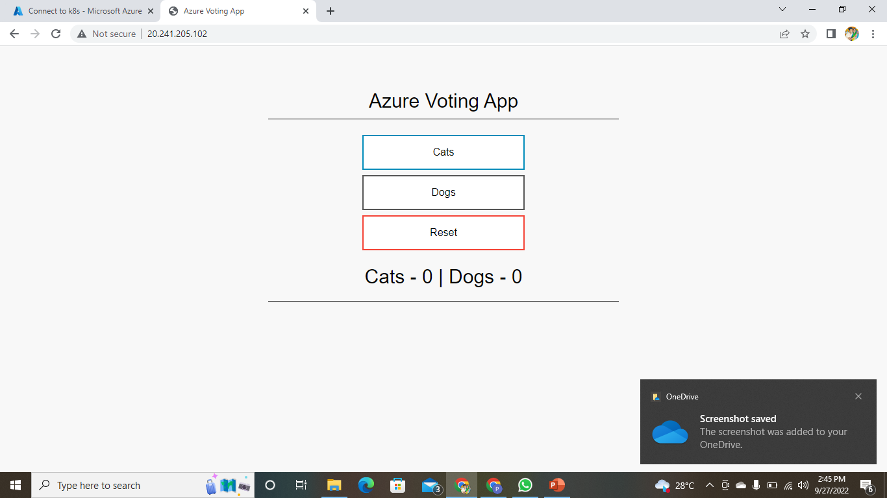
COPY THE EXTERNAL IP ADDRESS AND PASTE IT IN THE BROWSER TO GET THE OUTPUT

